Slide 1
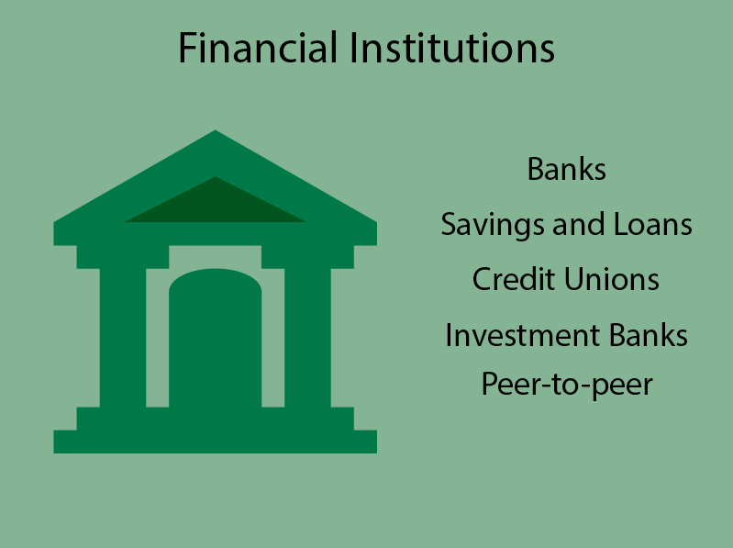
Government & The Community: The Role and Influence of Governments and other Bodies
Year 11 Accounting
This Photo by Unknown Author is licensed under CC BY-NC

Slide 2

What is the GST Act 1999 WA?
At the time it was A New Tax System (Goods and Services Tax) Act 1999 (the Act) provides the administrative framework for the goods and services tax (GST) law.
This is a tax of 10% on most goods
and services sold in Australia.
This Photo by Unknown Author is licensed under CC BY

Slide 3
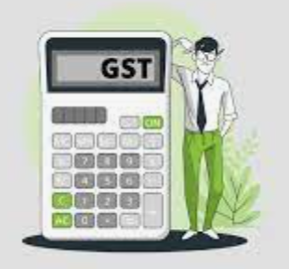
Do you have to pay GST if you earn under $75000?
If your GST turnover is below the $75,000, registering for GST is optional.
You may choose to register if your GST turnover is below the $75,000 threshold, however this means that once registered, regardless of your turnover, you must include GST in your fees and claim GST credits for your business purchases.
Is it worth registering for GST?
As a business owner, it's your responsibility to register for GST if your turnover exceeds the $75,000 threshold or is likely to exceed it. The ATO advises that if you've just started a new business and expect it to earn $75 000 or more in its first year of operation, you should register for GST.

Slide 4
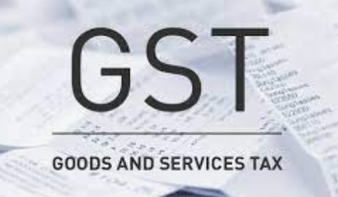
TRANSACTIONS AFFECTED BY GST
All transactions which involve or have involved the sale or purchase of goods or services involve GST
Except: GST Free Supplies, eg, childcare, charities, education, exports of goods and services, unprocessed food, health services, water, international travel;
Except: Input Taxed Supplies, eg, certain residential premises (peoples’ own home), residential rents, financial services (interest, life insurance, loans);

Slide 5
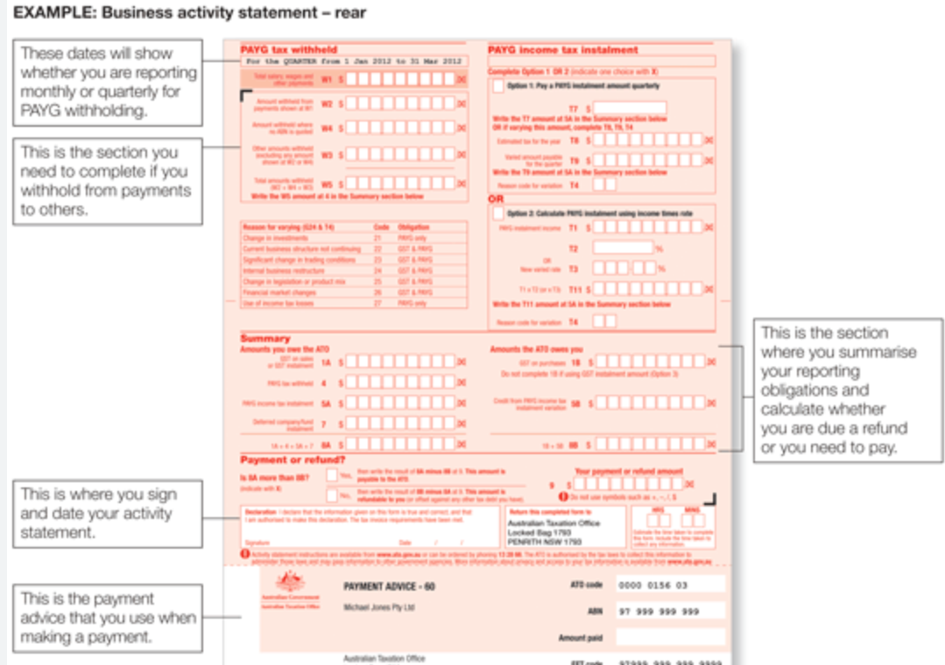
BUSINESS ACTIVITY STATEMENT
The BAS must be lodged with the ATO monthly, quarterly or annually
Most businesses earning more than $75 000 per year are required to lodge their BAS quarterly
The BAS can be lodged via the ATO’s website or by mail
The BAS must be received within 21 days of the end of each quarter

Slide 6

What are the requirements for the Business Name Registration Act 2011?
The requirements for registration of business name are minimal and simply involve names and identification of the partners or proprietors of the business, where more than one person is to register the business name.
The requirements may also include a partnership deed where necessary.

Slide 7
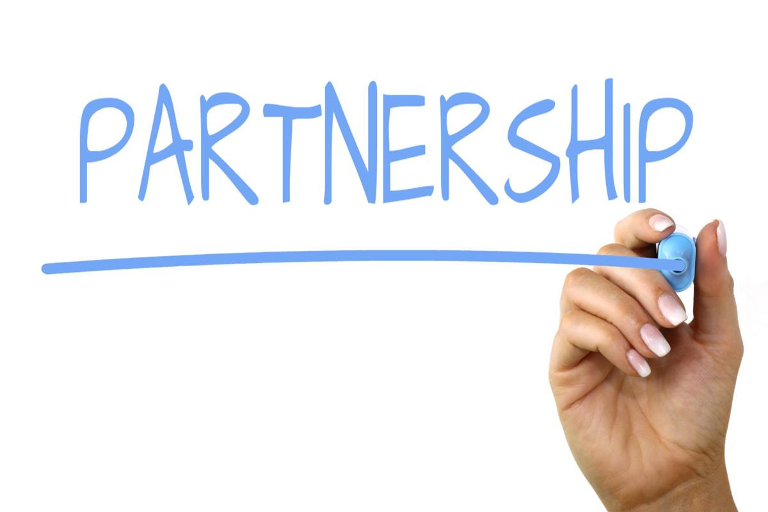
What does the Partnership Act 1895 WA regulate?
In Western Australia, partnerships are governed by the Partnership Act 1895. ... A general partnership is one in which all of the partners are responsible for the management of the business, and each partner has unlimited liability for the debts and obligations of the business.

Slide 8
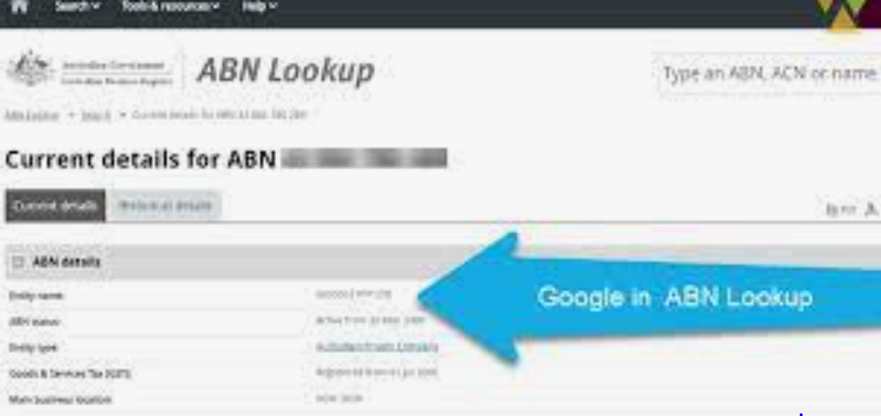
What is an ABN in Australia?
The Australian Business Number (ABN) is a unique
11 digit identifier issued to all entities registered
in the Australian Business Register (ABR).
The 11 digit ABN is structured as a 9 digit identifier with two leading check digits.
How much do you need to earn to have an ABN?
It is compulsory for businesses with a GST turnover of $75,000 or more to have an ABN and to be registered for GST. Businesses with a GST turnover of less than $75,000 can still apply for an ABN and may choose to register for GST once they have an ABN.

Slide 9
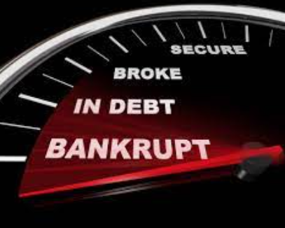
Bankruptcy Act 1966 WA
What is bankruptcy?
Bankruptcy is a legal process where you're declared unable
to pay your debts. It can release you from most debts, provide relief and allow you to make a fresh start.
You can enter into voluntary bankruptcy. To do this you need to complete and submit a Bankruptcy Form. It's also possible that someone you owe money to (a creditor) can make you bankrupt through a court process. We refer to this as a sequestration order.
Bankruptcy normally lasts for 3 years and 1 day.

Slide 10
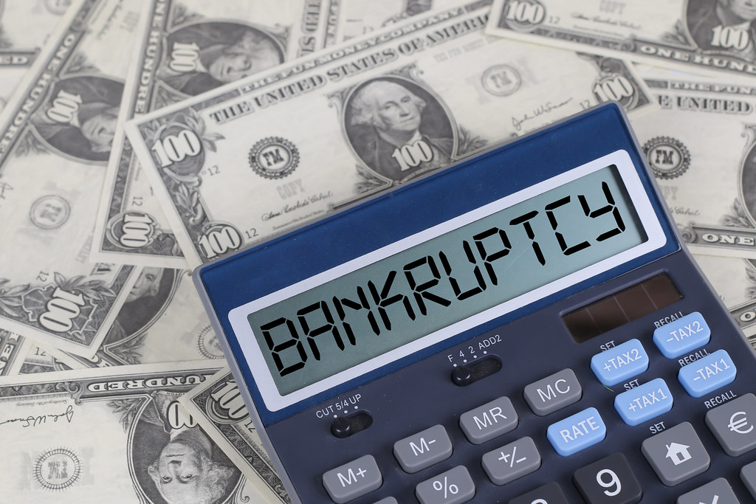
Bankruptcy Act 1966 WA
What happens when you declare bankruptcy in Western Australia?
When you are bankrupt: You must provide details of your debts, income and assets to your trustee.
Your trustee notifies your creditors that you're bankrupt - this prevents most creditors from contacting you about your debt. Your trustee can sell certain assets to help pay your debts.

Slide 11
Questions
Define GST.
Do all businesses have to register for GST? Explain.
What does GST exempt mean?
What is an ABN?
What is a BAS? How often does a BAS have to be lodged, usually?
What is a taxable supply?
Name three types of supplies and state whether GST is paid on them or not?

